Slide 1
Ward 5: Benning Road/ Rosedale Walk Muriel Bowser, Mayor
W a r d 6 : S o u t h w e s t W a t e r f r o n t C o m m u n i t y W a l k
M u r i e l B o w s e r , M a y o r
Office of Mayor Muriel Bowser
Mayor-Council Breakfast, June 23, 2015
Ward 5: Mayor Muriel Bowser‘s Benning Rd/ Rosedale
Neighborhood Walk
Wednesday, May 15, 2019
4:00 PM – 5:30 PM
Start: China House, 1601 Benning Rd NE
End: Safeway, 1601 Maryland Ave NE
1

Slide 2
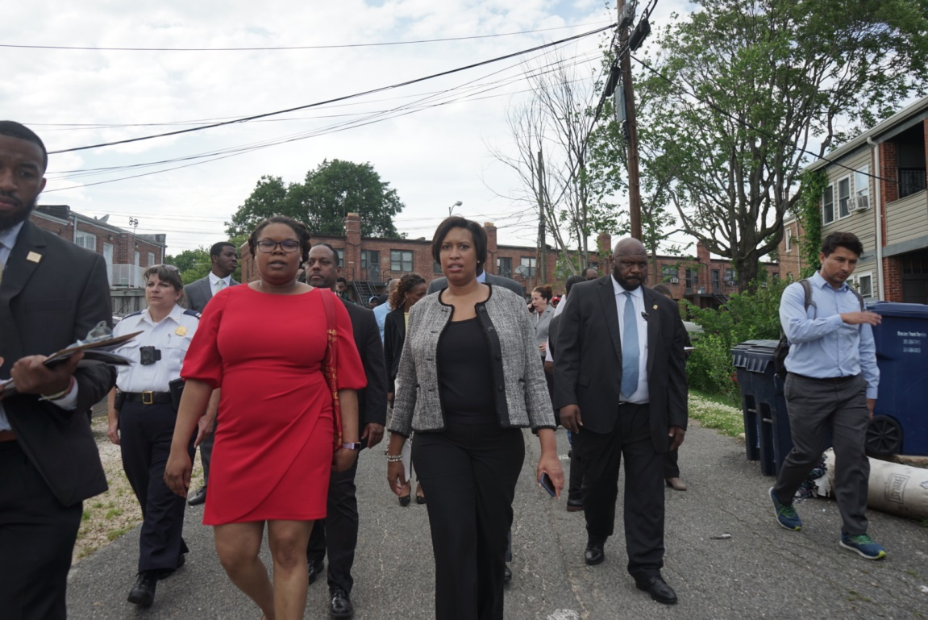
Ward 5: Benning Road/ Rosedale Walk Muriel Bowser, Mayor
W a r d 6 : S o u t h w e s t W a t e r f r o n t C o m m u n i t y W a l k
M u r i e l B o w s e r , M a y o r
Office of Mayor Muriel Bowser
Mayor-Council Breakfast, June 23, 2015 – FY’2016 Budget
On Wednesday, May 15, Mayor Bowser along with DPW hosted a press conference to address graffiti throughout Washington, DC. Mayor Bowser and DPW Director Chris Geldart kicked off DPW’s 4th Annual “Graffiti Wipe Out”.
Following the press conference, Mayor Bowser and a host of community members and government agencies conducted a community walk in the Rosedale/ Benning Road neighborhood. This report outlines those efforts in detail. The Mayor’s Office of Community Relations and Services (MOCRS) will follow up with the identified agencies for next steps and resolution.
2

Slide 3
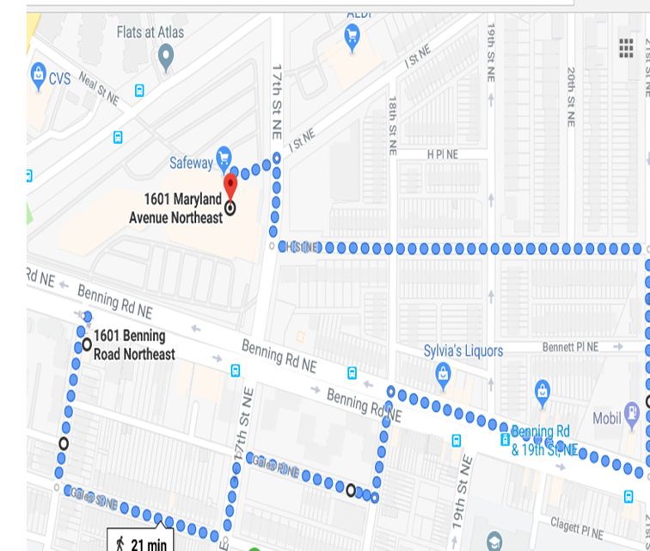
Ward 5: Benning Road/ Rosedale Walk Muriel Bowser, Mayor
W a r d 6 : S o u t h w e s t W a t e r f r o n t C o m m u n i t y W a l k
M u r i e l B o w s e r , M a y o r
Office of Mayor Muriel Bowser
Mayor-Council Breakfast, June 23, 2015 – FY’2016 Budget
Route Summary
Start: China House
● Head west to 16th street NE
● Head south towards Gales St NE
● Head East on Gales street NE
● Head North towards Gales Place
● Head East on Benning Rd
● Head North on 21st street NE
● Head West on H street NE
● Head North on 17th street NE
End: Safeway
3

Slide 4
Ward 5: Benning Road/ Rosedale Walk Muriel Bowser, Mayor
W a r d 6 : S o u t h w e s t W a t e r f r o n t C o m m u n i t y W a l k
M u r i e l B o w s e r , M a y o r
Office of Mayor Muriel Bowser
Mayor-Council Breakfast, June 23, 2015 – FY’2016 Budget
Community Participants
Gloria Beville, Neighborhood Action Team member
Bernice Blacknell, Commissioner, ANC5D04
Tamara Blair, Neighborhood Action Team member
Sydelle Moore, Commissioner, ANC5D05
Bob Coomber, Neighborhood Action Team member
Juanita Diggs, President of Carver Langston Citizens Association
Joann Johnson, Neighborhood Action Team member
John Hill, Neighborhood Action Team member
Wiley Martin, Neighborhood Action Team member
Steven Motley, Commissioner, ANC5D03
Lora Nunn, Neighborhood Action Team member
Sandra Phillips-Gilbert, Commissioner, ANC6A01
Yasmin Salina, Neighborhood Action Team member
Jade Stone, Neighborhood Action Team member
Shirley Worthy, Neighborhood Action Team member
4

Slide 5
Ward 5: Benning Road/ Rosedale Walk Muriel Bowser, Mayor
W a r d 6 : S o u t h w e s t W a t e r f r o n t C o m m u n i t y W a l k
M u r i e l B o w s e r , M a y o r
Office of Mayor Muriel Bowser
Mayor-Council Breakfast, June 23, 2015 – FY’2016 Budget
Administration Participants
Marcus Coates, Area manager, Department of Parks and Recreation (DPR)
Wesley Dawson, Outreach Specialist, District Department of Transportation (DDOT)
Anthony Diallo, Account Manager/Outreach Specialist, Department of Consumer and Regulatory Affairs (DCRA)
Kevin Donahue, Deputy Mayor, Deputy Mayor of Public Safety and Justice (DMPSJ)
Polly Donaldson, Director, Department of Housing and Community Development (DHCD)
Christopher Dyer, Office of Victim Services and Justice Grants (OSVJG)
Ashley Emerson, Director, Mayor’s Office on African American Affairs (MOAAA)
William Fitzgerald, Fifth District Commander, Metropolitan Police Department (MPD)
Christopher Geldart, Director, Department of Public Works (DPW)
Larry Handerhan, Chief of Staff, Department of Human Services (DHS)
Travis Hughes, Community Outreach, Department
of Behavioral Health (DBH)
Julia Irving, Director, Mayor’s Office of Community Relations and Services (MOCRS)
Tyon Jones, Community Outreach Specialist, District Department of Transportation (DDOT)
Julie Lawson, Director, Mayor’s Office of Clean City (MOCC)
Reginald May, Deputy Associate Administrator, Department of Public Works (DPW)
Delbert McFadden, Director, Office of Neighborhood Safety and Engagement (ONSE)
Bandele McQueen, Director, DC Housing Authority (DCHA)
Jay Melder, Assistant City Administrator
Unique Morris-Hughes, Director, Department of Employment Services (DOES)
Ashley Rosenthal, 5D SCI Captain, Metropolitan Police Department (MPD)
John Stokes, Interim Associate Director of External Affairs, Department of General Services ( DGS)
Kristi Whitfield, Director, Department of Small and Local Business Development (DSLBD)
5

Slide 6
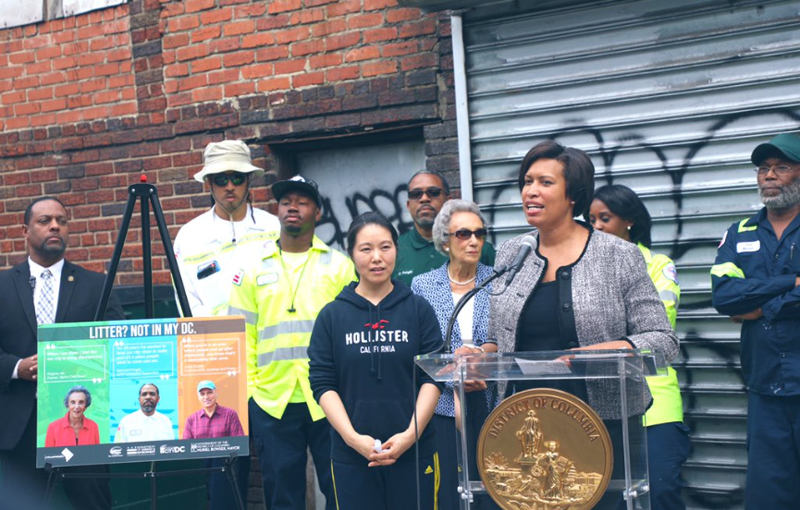
Ward 5: Benning Road/ Rosedale Walk Muriel Bowser, Mayor
W a r d 6 : S o u t h w e s t W a t e r f r o n t C o m m u n i t y W a l k
M u r i e l B o w s e r , M a y o r
Office of Mayor Muriel Bowser
Mayor-Council Breakfast, June 23, 2015 – FY’2016 Budget
Before the walk, Mayor Bowser hosted a press conference with DPW to kick off the 4th Annual Great Graffiti Wipeout. Following the press conference, members of the press joined Mayor Bowser for the walk and asked questions about sidewalk infrastructure, illegal dumping, and vacant properties along the route.
6

Slide 7
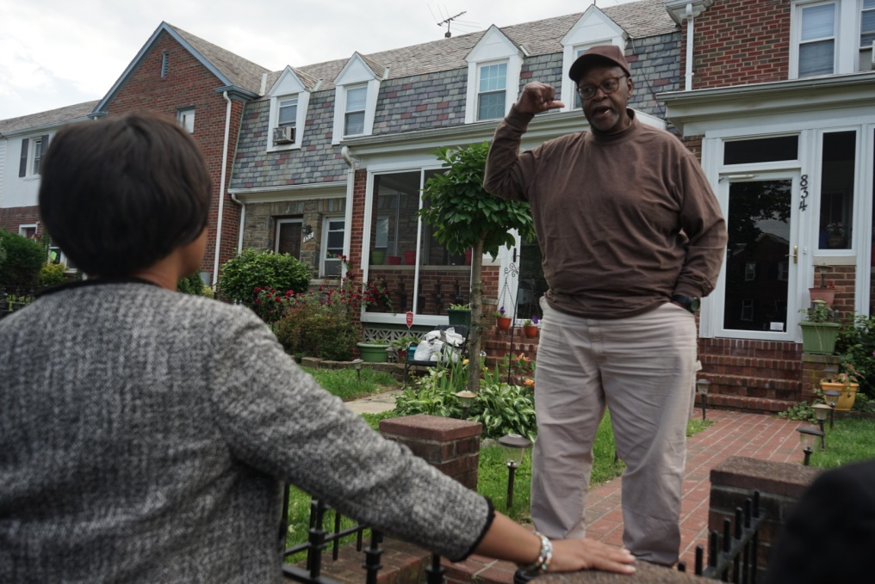
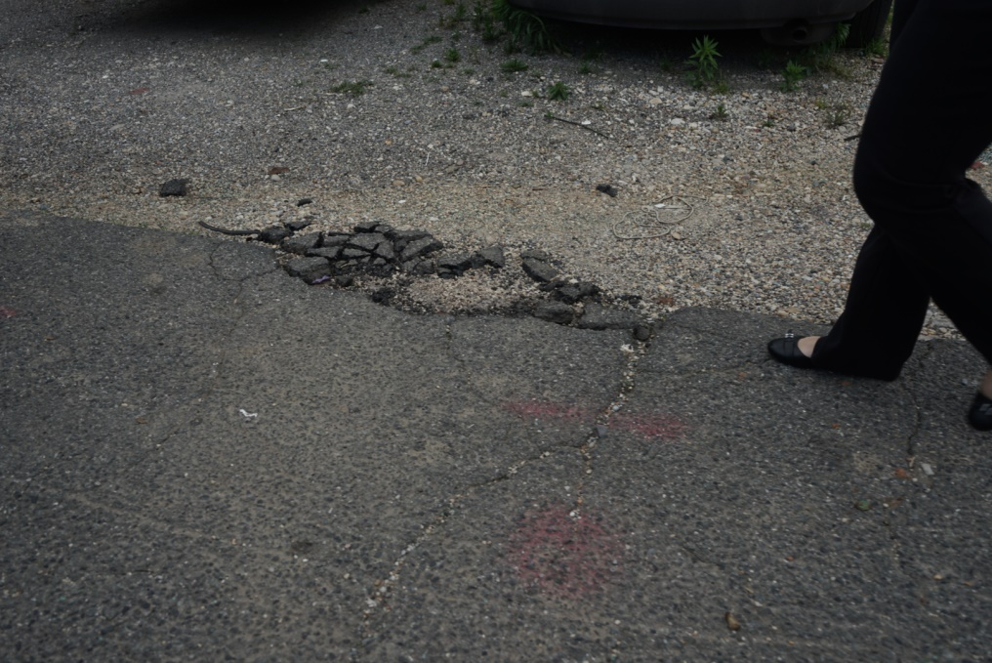
Ward 5: Benning Road/ Rosedale Walk Muriel Bowser, Mayor
W a r d 6 : S o u t h w e s t W a t e r f r o n t C o m m u n i t y W a l k
M u r i e l B o w s e r , M a y o r
Office of Mayor Muriel Bowser
Mayor-Council Breakfast, June 23, 2015 – FY’2016 Budget
Community member from the Carver Langston neighborhood highlighted cracked pavement in the alleyway of the 800 block of 20th street NE.
7

Slide 8
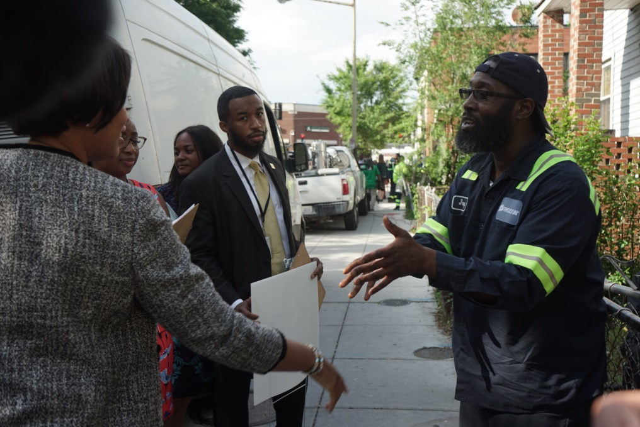
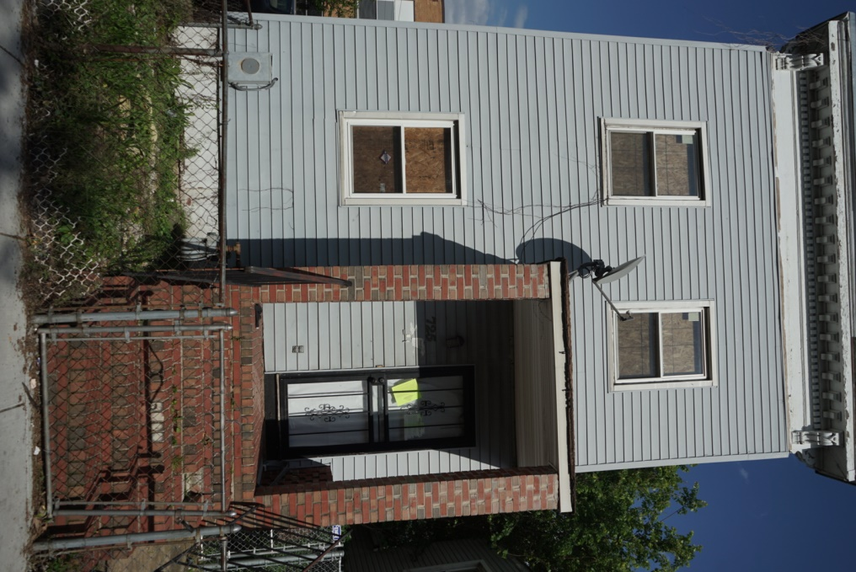
Ward 5: Benning Road/ Rosedale Walk Muriel Bowser, Mayor
W a r d 6 : S o u t h w e s t W a t e r f r o n t C o m m u n i t y W a l k
M u r i e l B o w s e r , M a y o r
Office of Mayor Muriel Bowser
Mayor-Council Breakfast, June 23, 2015 – FY’2016 Budget
A number of vacant properties were identified during the walk.
Mayor Bowser engaged with residents and shared how District government can help with improving the community.
8

Slide 9
Ward 5: Benning Road/ Rosedale Walk Muriel Bowser, Mayor
W a r d 6 : S o u t h w e s t W a t e r f r o n t C o m m u n i t y W a l k
M u r i e l B o w s e r , M a y o r
Office of Mayor Muriel Bowser
Mayor-Council Breakfast, June 23, 2015 – FY’2016 Budget
Issues Identified and Status
ISSUE | LOCATION/ADDRESS | AGENCY RESPONSIBLE | SLA | STATUS
Overgrown trees | 20th & I Street NE | DDOT | FY19 | Open
Hanging Wires | 824 20th Street NE (Alleyway) | TBD | FY19 | Open
Vacant Property | 1901 H Street NE | FY19 | FY19 | Open
Abandoned Vehicle | 1825 H Street NE (Alleyway) /807 20th Street NE/ | DPW | FY19 | Open
Litter can replace | 1800 block of H Street NE | DPW | FY19 | Open
Overgrown grass | 1724 H Street NE | DDOT | FY19 | Open
Sidewalk Repavement | 1700 block of H Street | DDOT | FY20 | Open
DCHA lot with unknown contaminants | 1920 Benning Road | DCHA | FY19 | Open
Capital Bikeshare Bicycle | 720 21st NE/850 20th Street NE | DDOT | FY19 | Open
Sidewalk Repavement | 1941 H Street NE | DDOT | FY19 | Open
Commercial vehicle | 826 20th Street NE | DDOT | FY19 | Open
Unsecured construction | 826 20th Street NE | DCRA | FY19 | Open
Man Hole Cover | 19th and Gales Street NE | DC WATER | FY19 | Completed
9

Slide 10
Ward 5: Benning Road/ Rosedale Walk Muriel Bowser, Mayor
Issues Identified and Status
ISSUE | LOCATION/ADDRESS | AGENCY RESPONSIBLE | SLA | STATUS
Hole in sidewalk | 17th and Gales | DDOT | FY19 | Open
4 way stop sign | 19th and I Street NE | DDOT | FY19 | Open
Porta-John flipped over | 816 20th Street NE | DCRA | FY19 | Open
Nuisance Property | 1901 H Street NE | MPD | FY19 | Open
Tree box clean up | 1900 Bennett Place | DPW | FY19 | Open
Over load trash can | 1701 Gales Street NE | DPW | FY19 | Open
Playground Swings | Miner Elementary School | DGS | FY19 | Open
Vacant property (find out about tax) | 725 16th Street NE | DCRA | FY19 | Open
Rear gate vacant property | 713 16th Street NE | DCRA | FY19 | Open
Tree trimming | 1608 Gales Street NE | DDOT | FY19 | Open
Sidewalk infrastructure | 1630 Gales Street NE | DDOT | FY19 | Open

